Slide 1
Memory management – UNOFFICIAL SUMMARY
Storing processes in main memory

Slide 2
Memory Management
To take advantage of multiprogramming and multitasking, a continuous supply of ready processes is needed
Memory management is required to
Ensure a smooth movement of processes from secondary storage to main memory
Sharing of main memory among multiple processes in a systematic way
Efficient memory access for processes running on CPU

Slide 3
Memory Management Requirements
Sharing
Protection
Logical Addressing
Physical Addressing
Relocation

Slide 4
Memory Management Requirements
Sharing
Processes should be allowed to use each other’s data legally through IPC
Protection
Processes should not be allowed to use each other’s data without proper permissions

Slide 5
Memory Management Requirements
Logical Addressing
Logical addresses are used by the CPU during the execution of a process
They are relative to the beginning of a process in memory
Physical Addressing
Physical addresses are actual / absolute addresses relative to the beginning of the main memory
Main memory requires these addresses to access different parts of a process

Slide 6
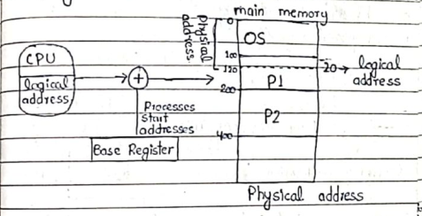
Memory Management Requirements
Relocation
Translation of logical addresses into physical addresses
In simple terms,
physical address = Logical address + base register
Base register holds the starting physical address of a process in main memory
The process of relocation is performed by the memory management unit (MMU)

Slide 7
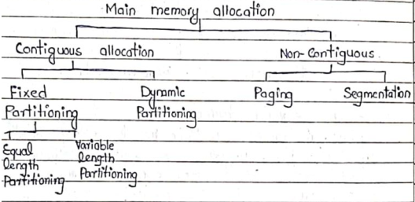
Types Memory Allocation
Contiguous Allocation
Non-Contiguous Allocation

Slide 8
1. Contiguous Allocation
Each process is stored together in contiguous memory locations
Used in old operating systems during the early days of computers
Types:
1A. Fixed Partitioning
1B. Dynamic Partitioning

Slide 9
1A. Fixed Partitioning
Main memory is divided into fixed size partitions
A whole process must be kept in single partition
What if the process is bigger than available partitions?
Solution: Use overlays
Suffers from internal fragmentation
Types:
Equal-Length Partitioning:
All the partitions are of the same length
Variable-Length Partitioning:
Partitions are of different lengths.
Tries to reduce internal fragmentation

Slide 10
Overlays
If a program is bigger than any available partition, then the programmer can divide a large program into sub-parts called overlays
These sub-parts can be loaded and executed one after another
Done by the programmer, not by the OS

Slide 11
Internal Fragmentation
Normally, a process is smaller than the partition in which is stored
The remaining space in the partition cannot be allocated to any other process
This wasted space inside the partition is called internal fragmentation

Slide 12
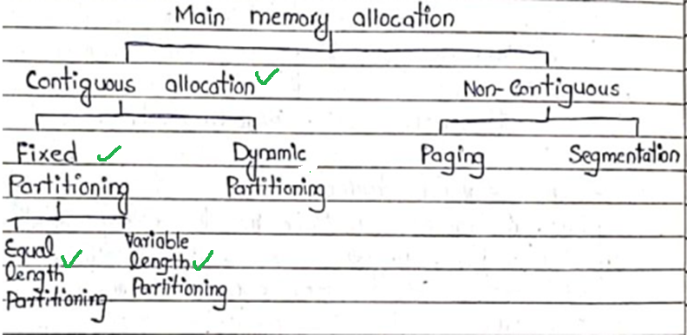

Slide 13
1B. Dynamic Partitioning
Initially, the main memory is not divided into any partitions
When processes enter the main memory, they are allocated as much space as they require
However, when processes leave the main memory, small partitions of memory become available
called holes
Suffers from external fragmentation
Which hole to select for a new process?
First-Fit
Best-Fit
Worst-Fit

Slide 14
External Fragmentation
When processes leave the main memory, holes become available
Even though total amount of memory exists to load a new process, but the available holes are not contiguous
External fragmentation occurs when memory is available to load a new process, but it is not contiguous
Compaction:
Used to solve external fragmentation
Processes can be shifted up the memory to get one big hole
Time consuming

Slide 15
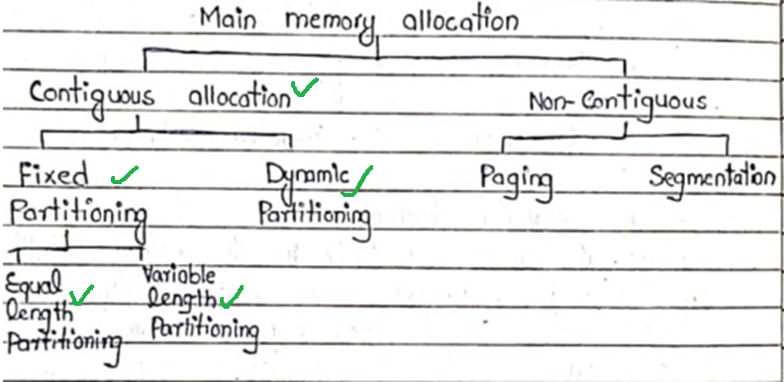

Slide 16
2. Non-Contiguous Allocation
Processes can be scattered throughout the main memory and virtual memory
Used in modern operating systems
Two main types:
2A. Paging
2B. Segmentation

Slide 17
2A. Paging
Memory is divided into equal-sized chunks called frames
Processes are also divided into equal-sized chunks called pages
Where, page size = frame size
Except for the last page
Pages of a process can be scattered throughout the memory
Each process has its own page table
Which records the frames in which different pages are stored
Relatively simple
Suffers from internal fragmentation

Slide 18
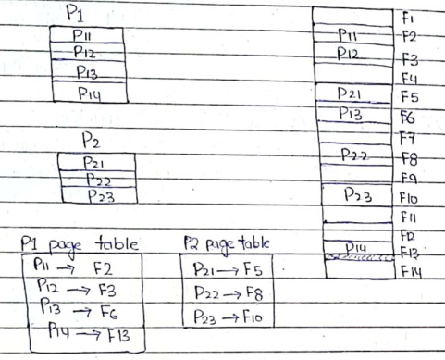
2A. Paging

Slide 19
2B. Segmentation
There are no fixed frames in the memory
Processes can be divided into chunks of different sizes
called segments
These segments can be scattered throughout the memory
There is no internal fragmentation, but there is some external fragmentation
More flexible than paging
More complicated to implement as compared to paging

